Slide 1
HEALTH INFORMATION SYSTEM
Software Engineering Intern Task

Slide 2
Introduction
April 2025.

Slide 3
Tasks
Create a health information system that allows a system user to do the following.
Register a new client in the system.
Enrol a client in one or more programs.
Search for a client from a list of registered clients.
View a client's profile, including the programs they are enrolled in.
Expose the client profile via an API, so that other systems can retrieve this information.

Slide 4
Aim
The main aim is to Design and Develop a health information system with the specified functionalities.

Slide 5
Objectives
Design and develop a database system to store an manage all the information required to run the system
Design and develop an API based backend system to manage the data from the database and also serve the front end.
Design and develop a frontend system to provide a user friendly interface where the system users will be able to interact with the system seamlessly.
Test the system functionality and security to ensure it addresses the challenge correctly while also adhering to security standards.

Slide 6
Proposed solution
A web-based Django application that will follow an API-First approach in the development of the system.
This way the development and the system itself will be flexible enough to work with and enable the developer to focus on specific modules on the system which will improve on the quality on the system developed.

Slide 7
System design overview
The system’s backend will be developed using Django as it comes with fantastic features for security and also has enough build in tools to speed up the process of development.
The system front end will rely on Django templates
A relational database like MySQL will be used to manage the data.

Slide 8
Stimuli & response
System user registers their account on the system
System saves the data and allows the user to login
The user login
System allows the user to manage programs and clients.

Slide 9
Demonstration.
Registration(slide 10,11 and 12),
login(slide 13),
Authentication token(slide 14) ,
System overview(15,16,…,24),
logout(25),
Password reset(slides 26,27,…,30).

Slide 10
Demonstration.
System overview(15,16,…,24),
Register a new client in the system.(slide 20 )
Enrol a client in one or more programs.(slide 23)
Search for a client from a list of registered clients.(slide 25)
View a client's profile, including the programs they are enrolled in.(slide 24)

Slide 11
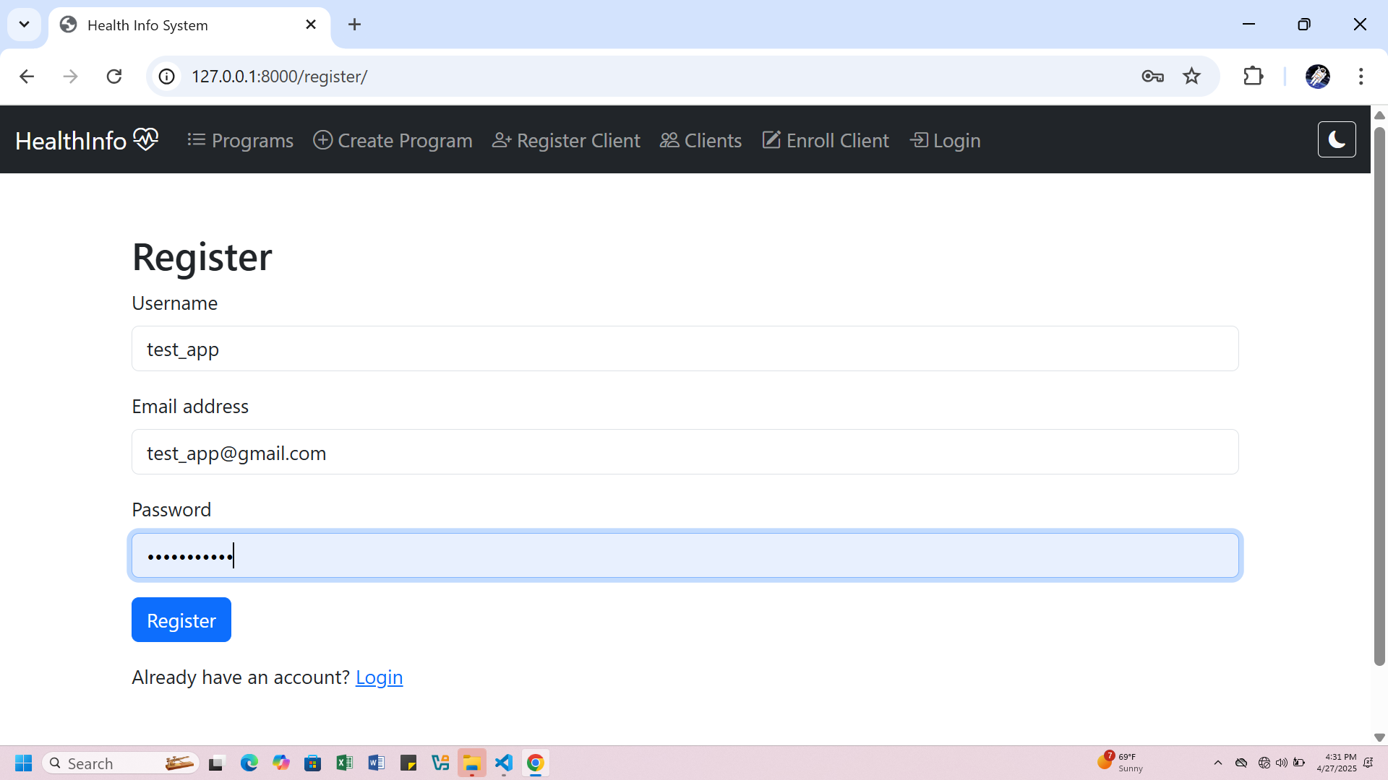
Registration

Slide 12
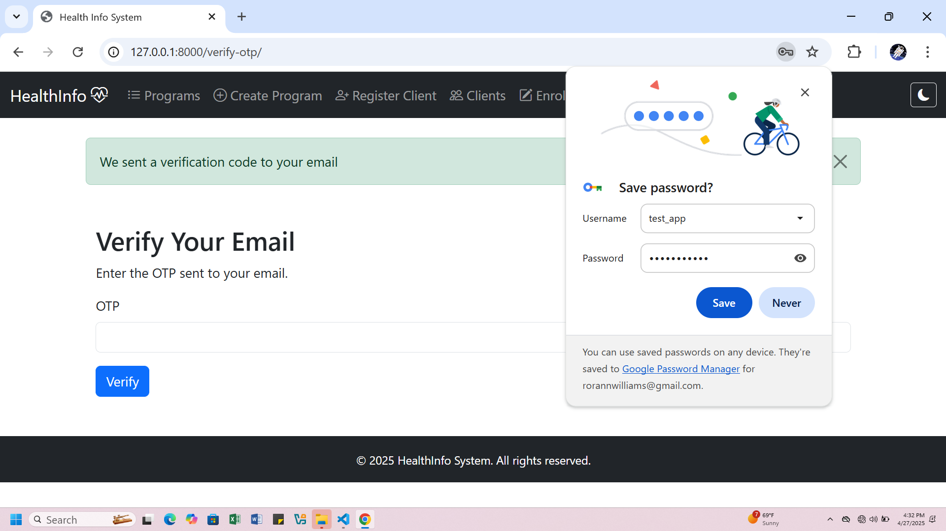

Slide 13
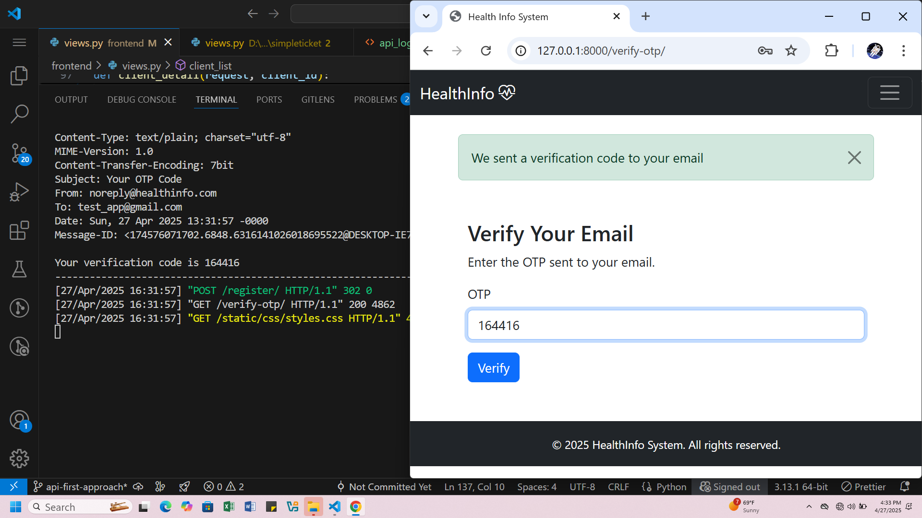

Slide 14
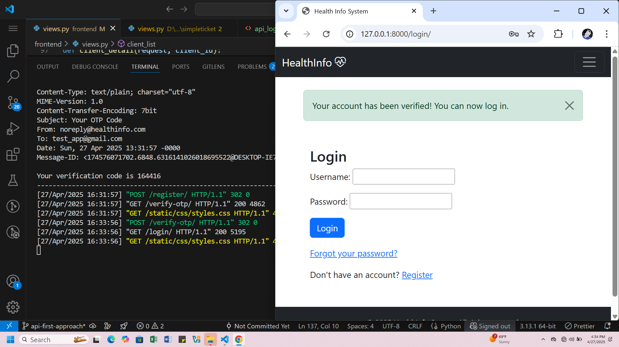

Slide 15
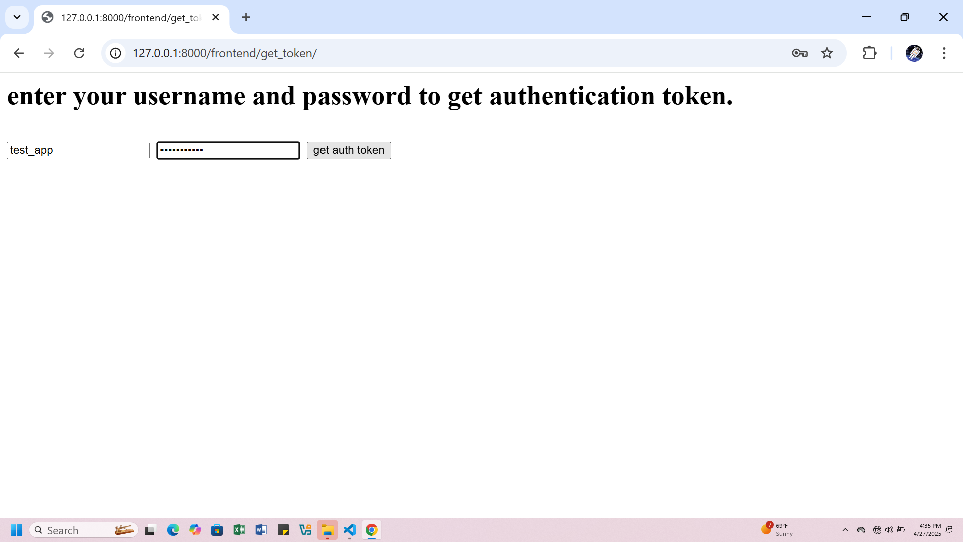

Slide 16
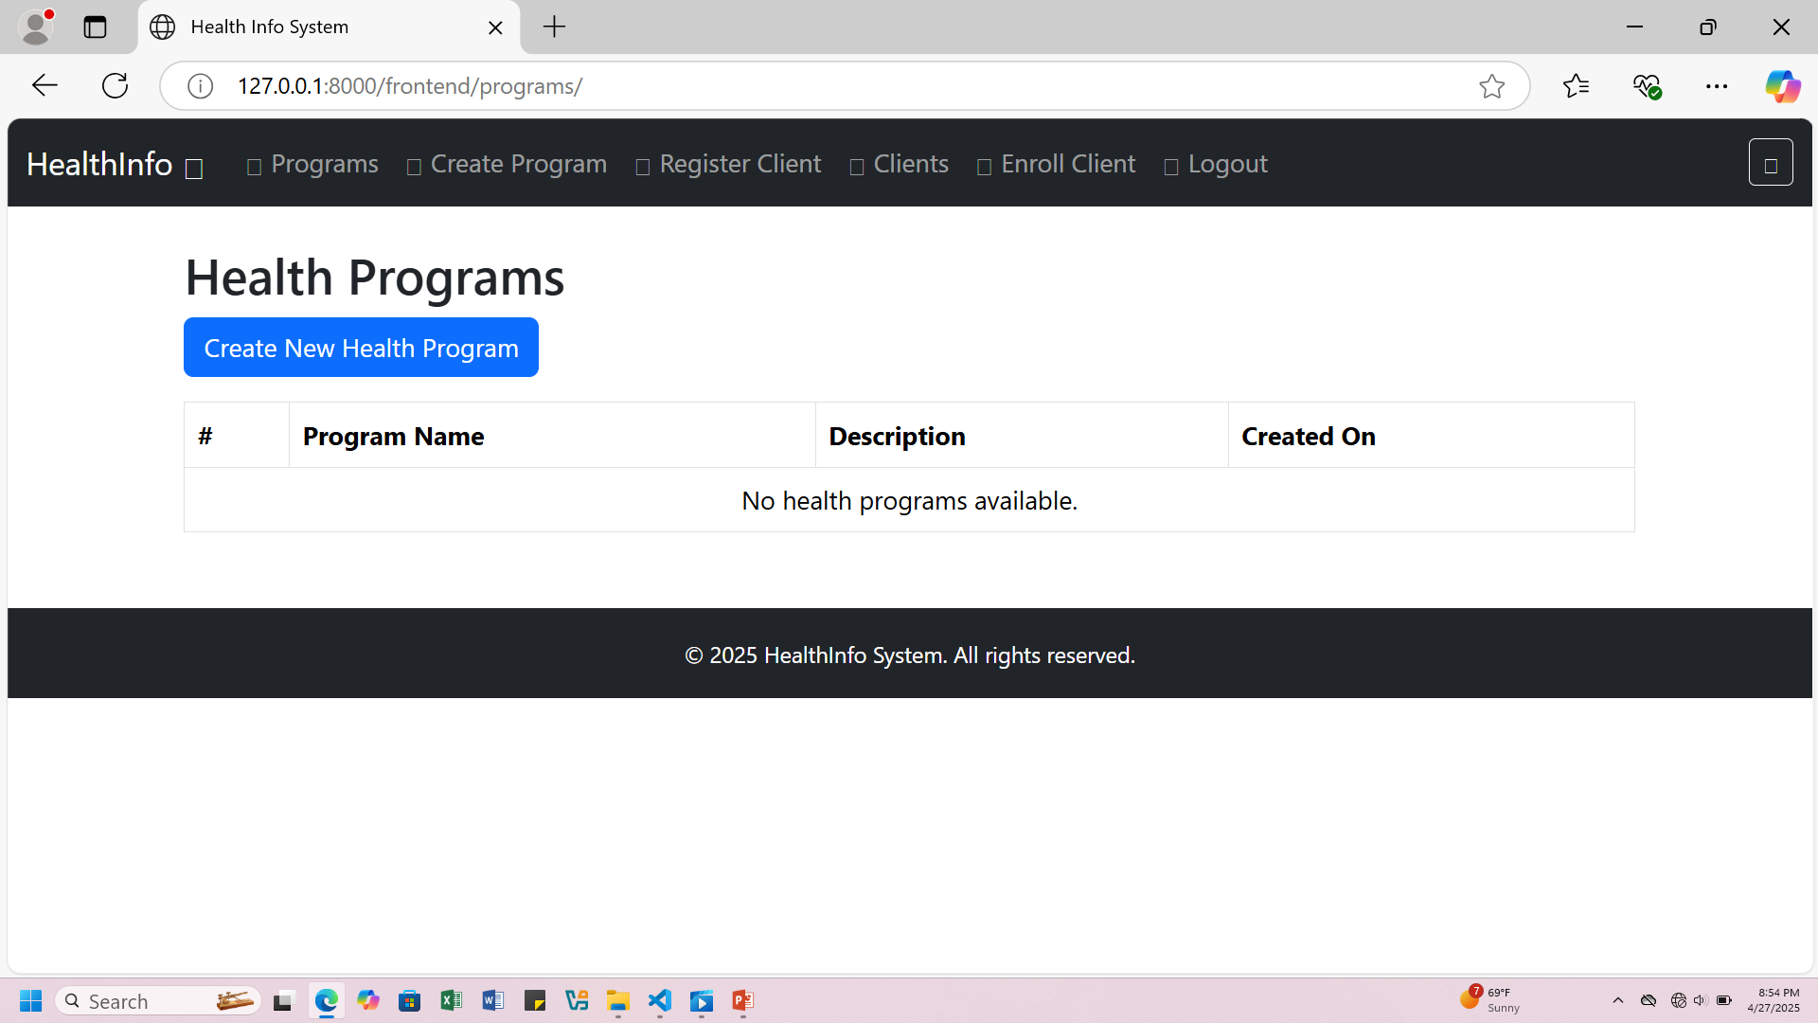

Slide 17
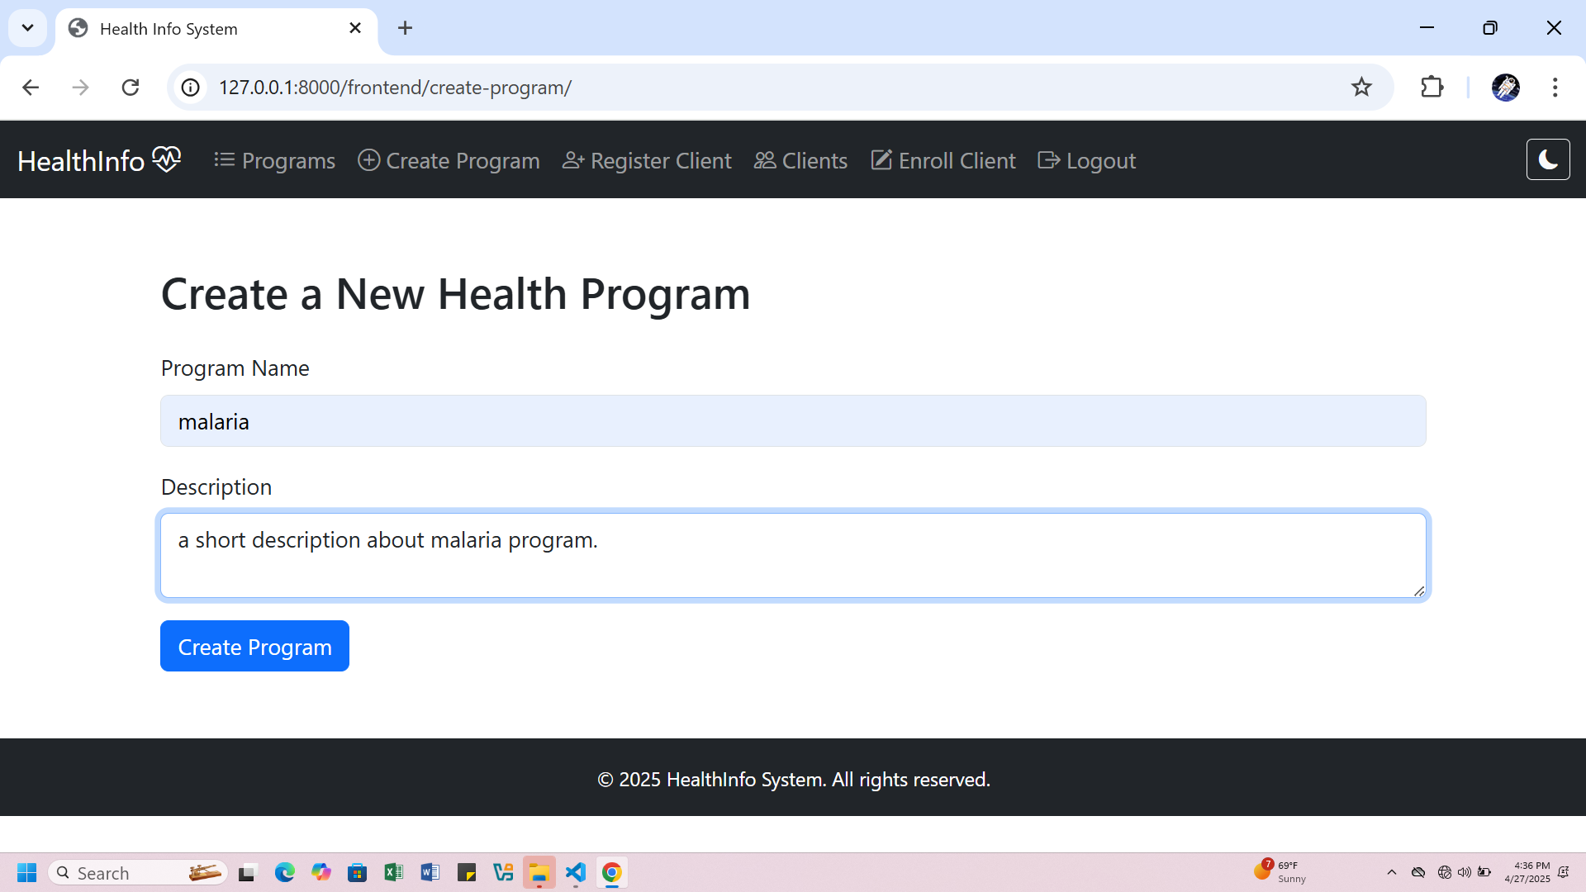

Slide 18
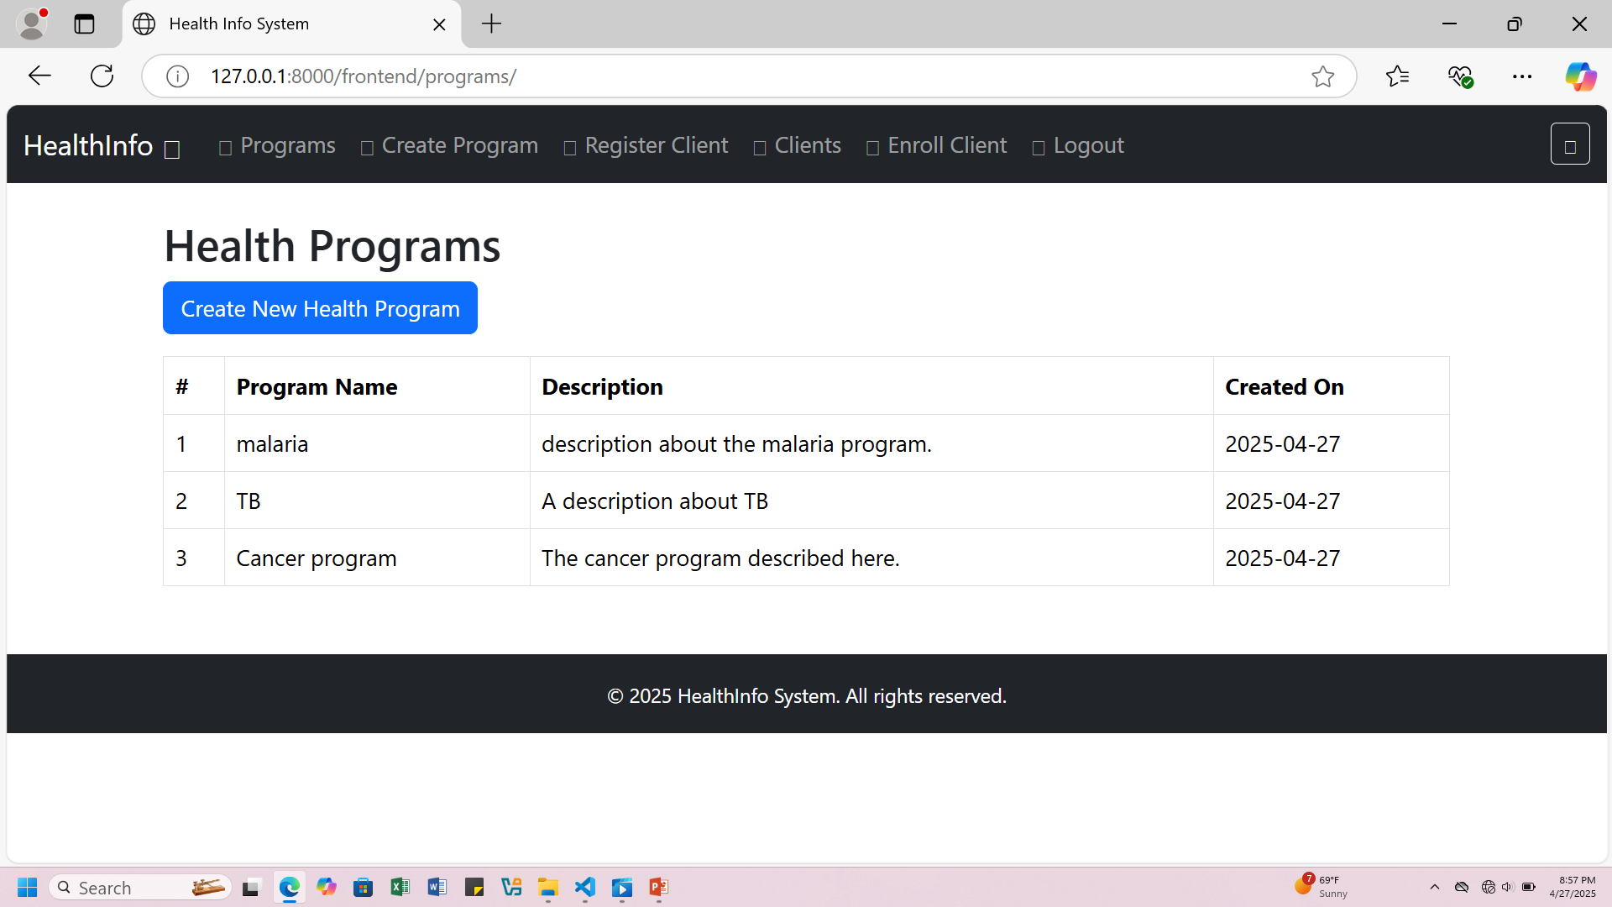

Slide 19
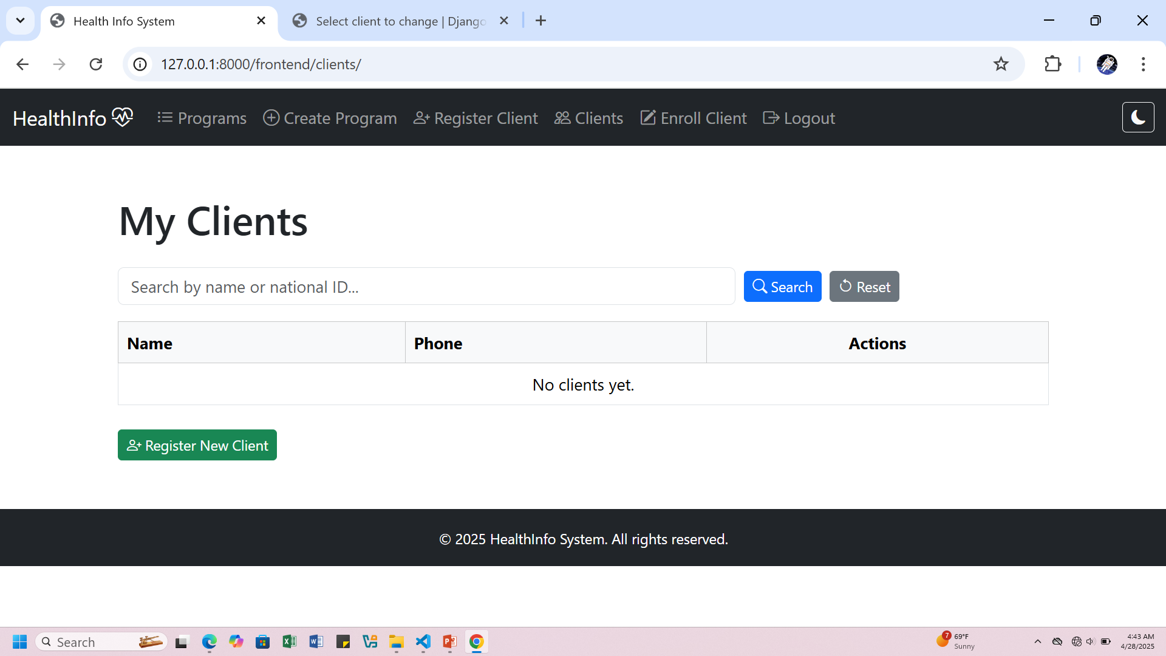

Slide 20
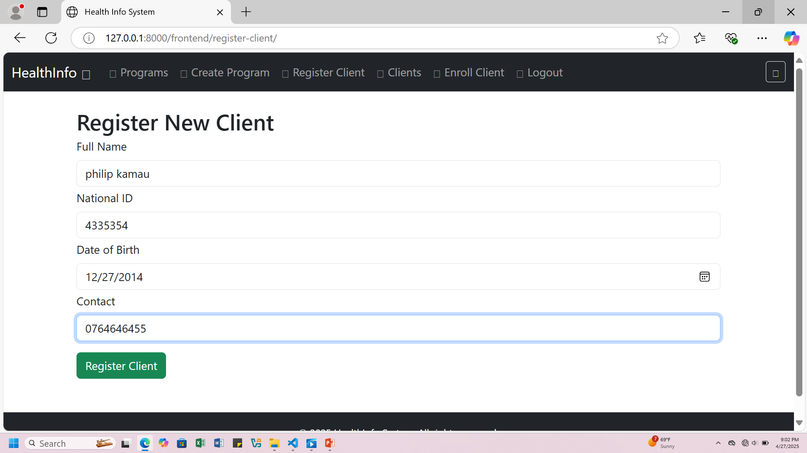

Slide 21
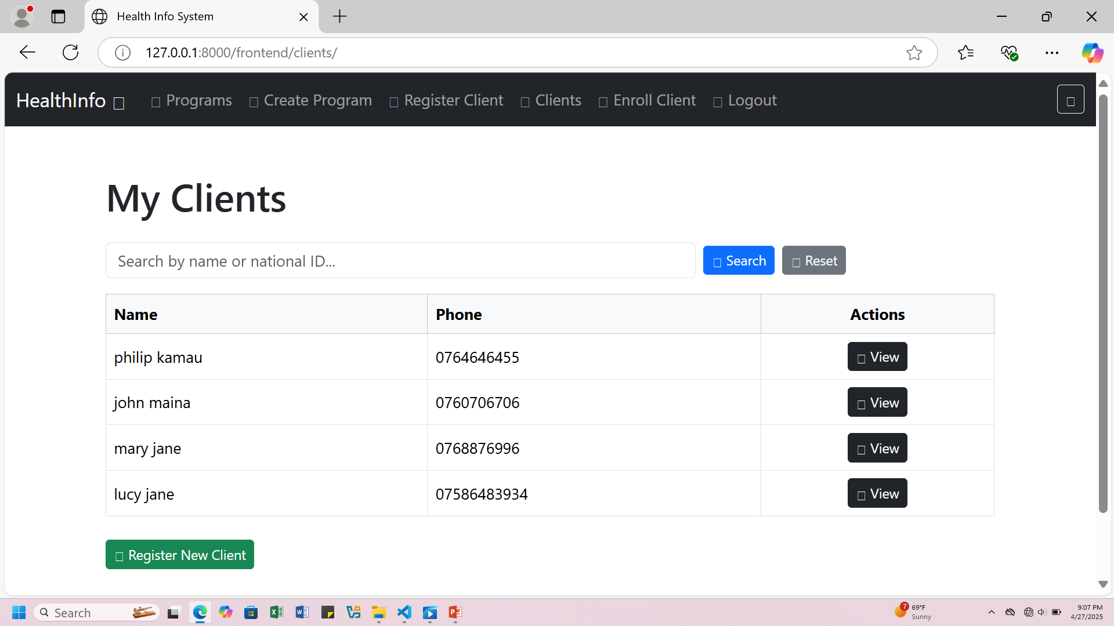

Slide 22
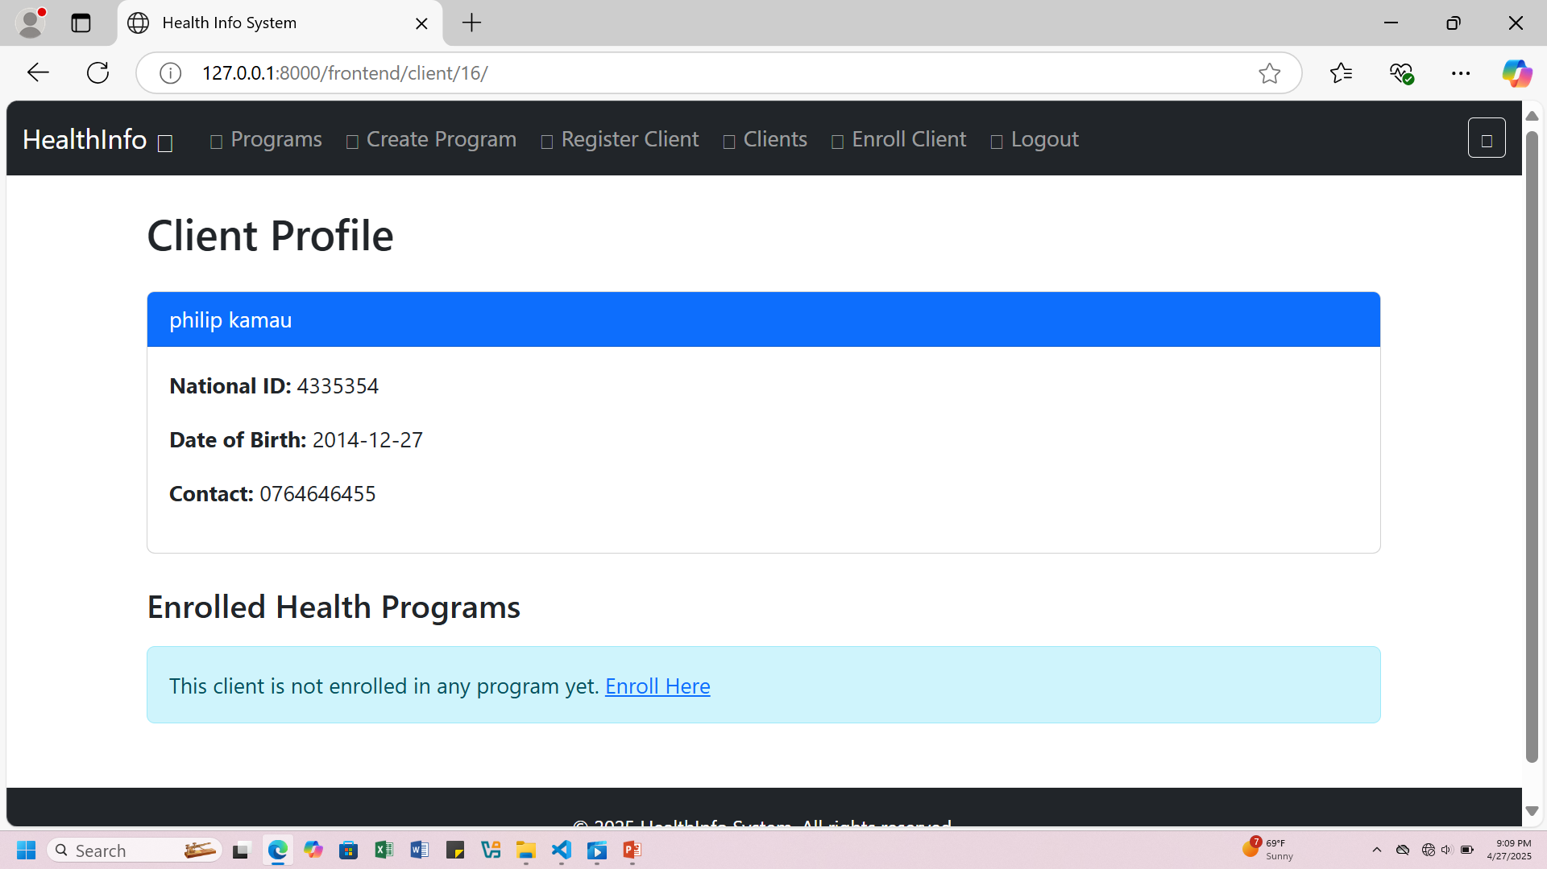

Slide 23
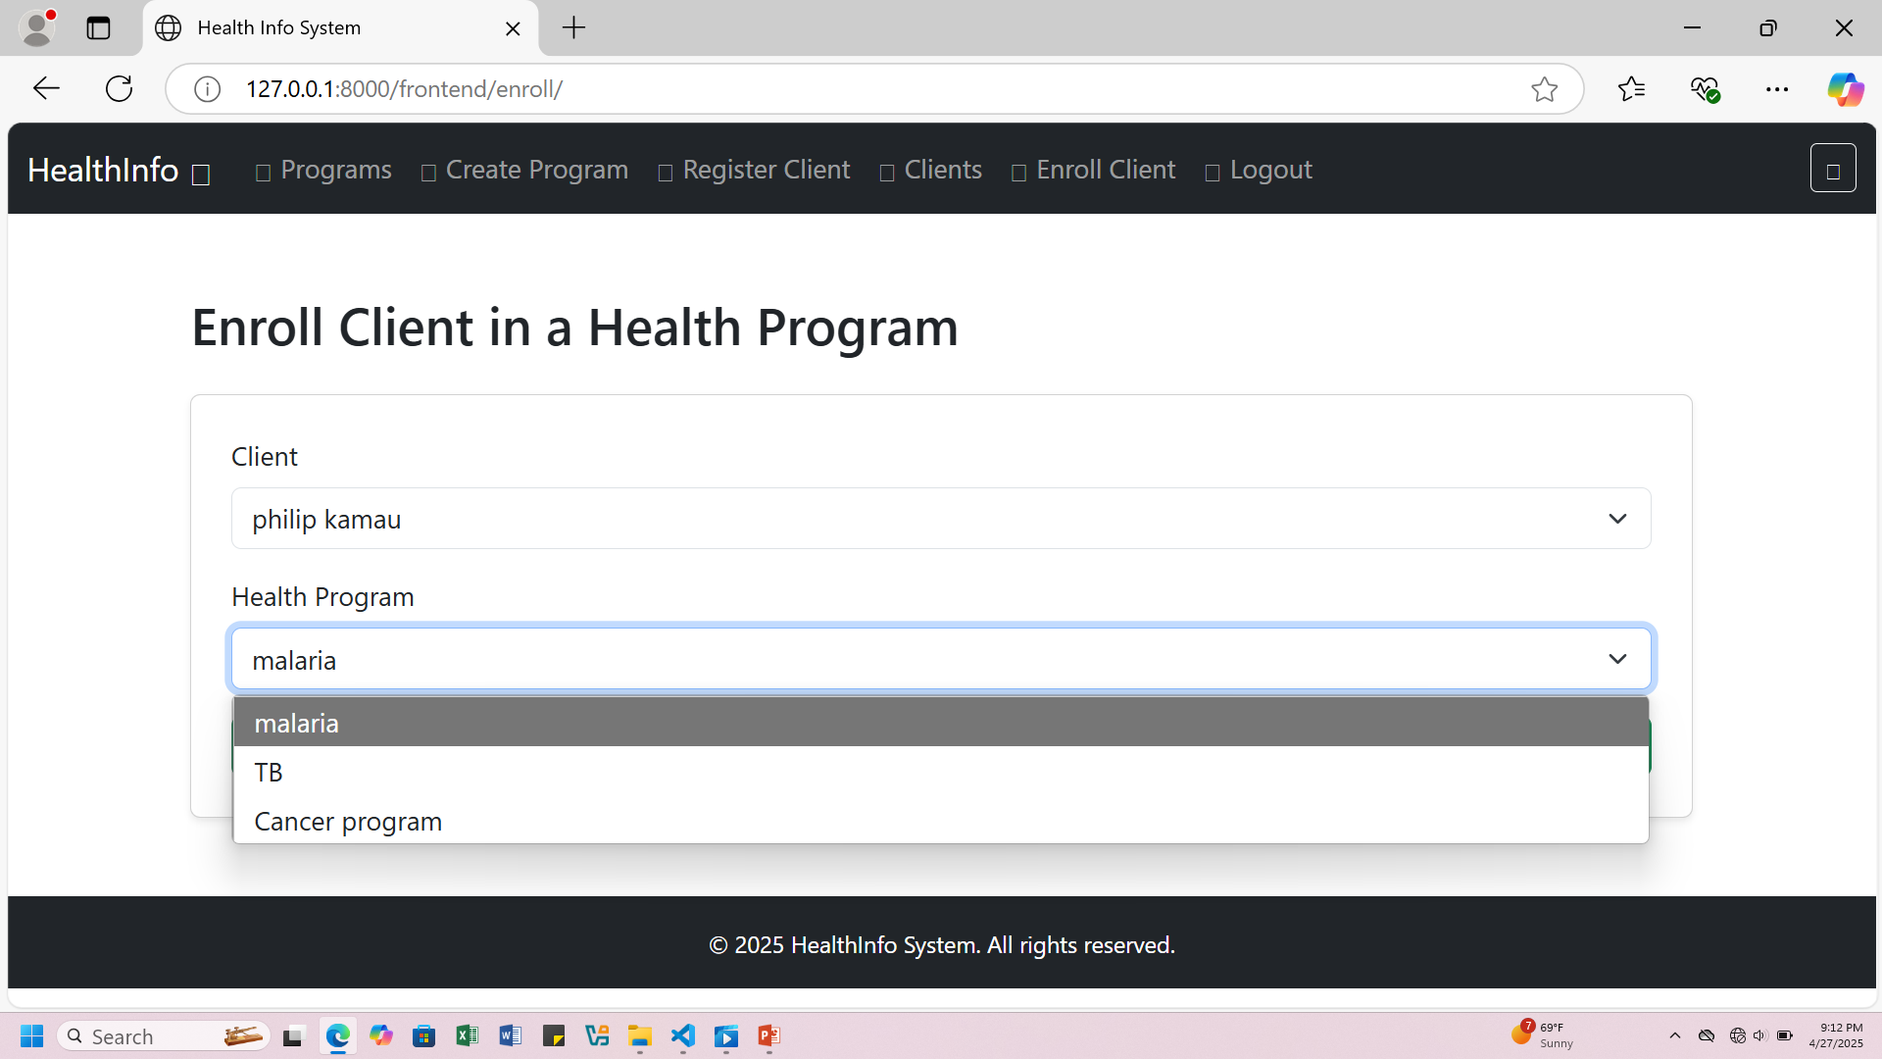

Slide 24
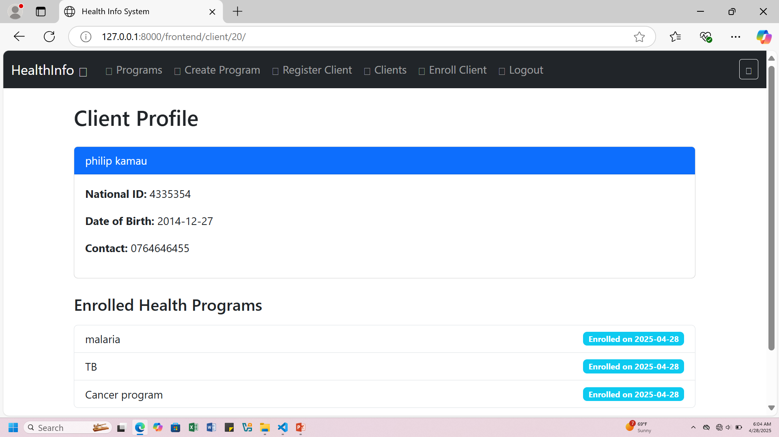

Slide 25
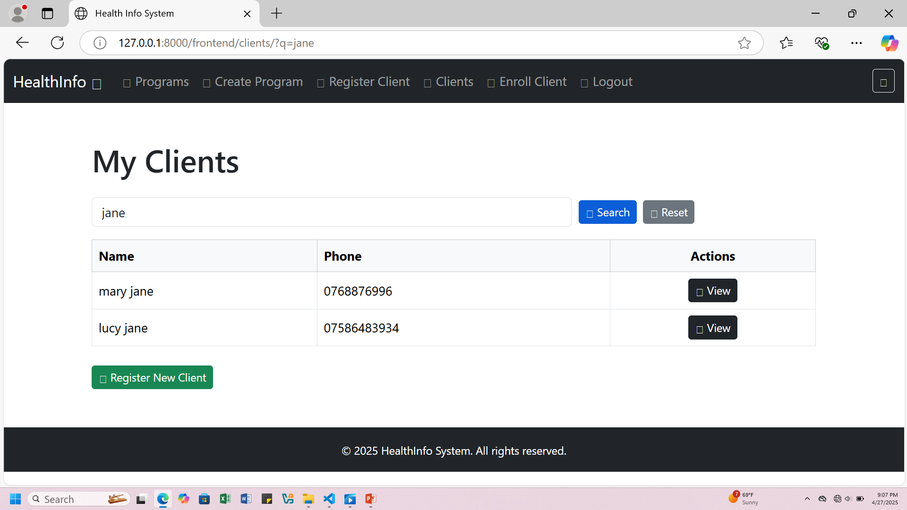

Slide 26
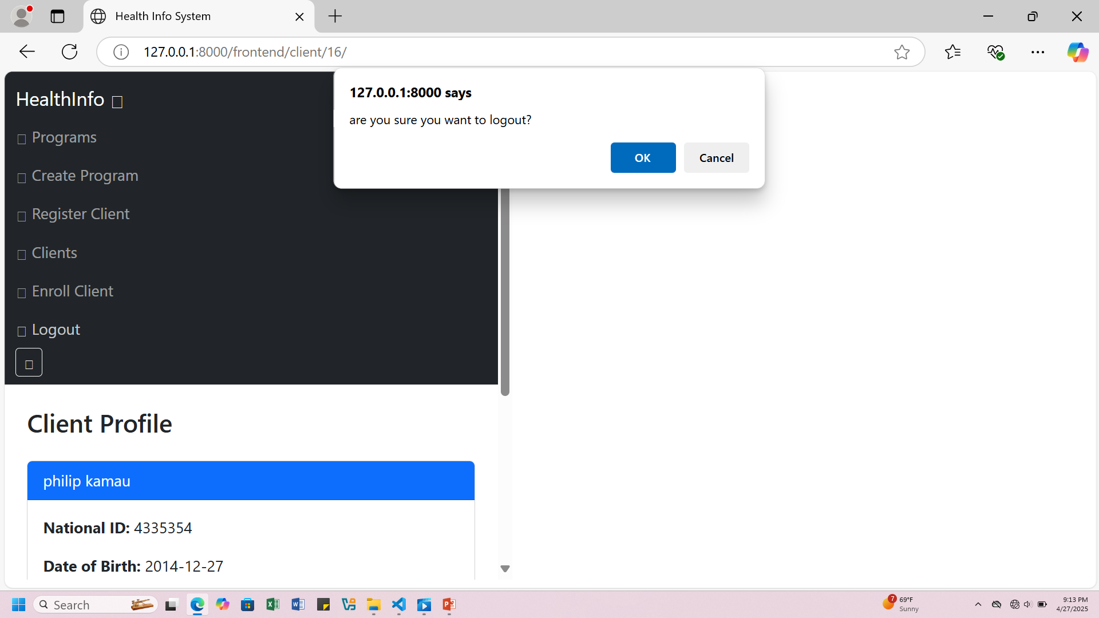

Slide 27
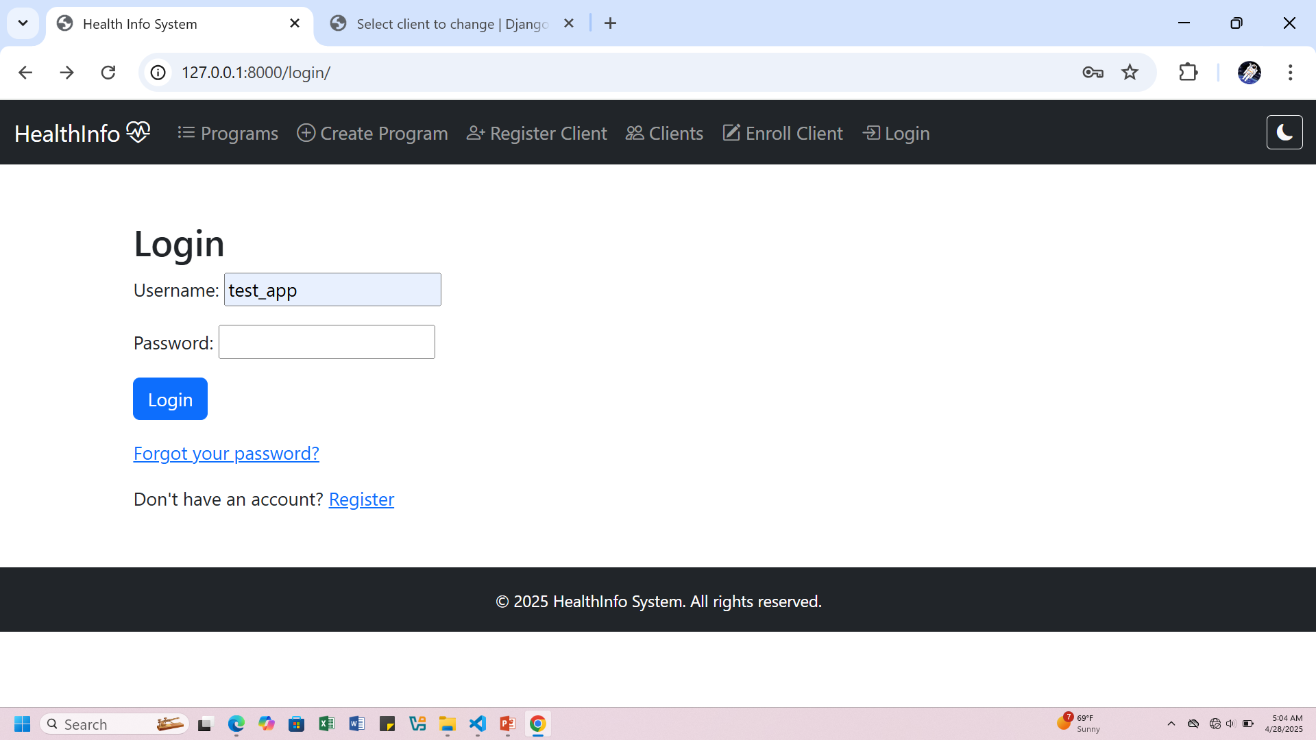

Slide 28
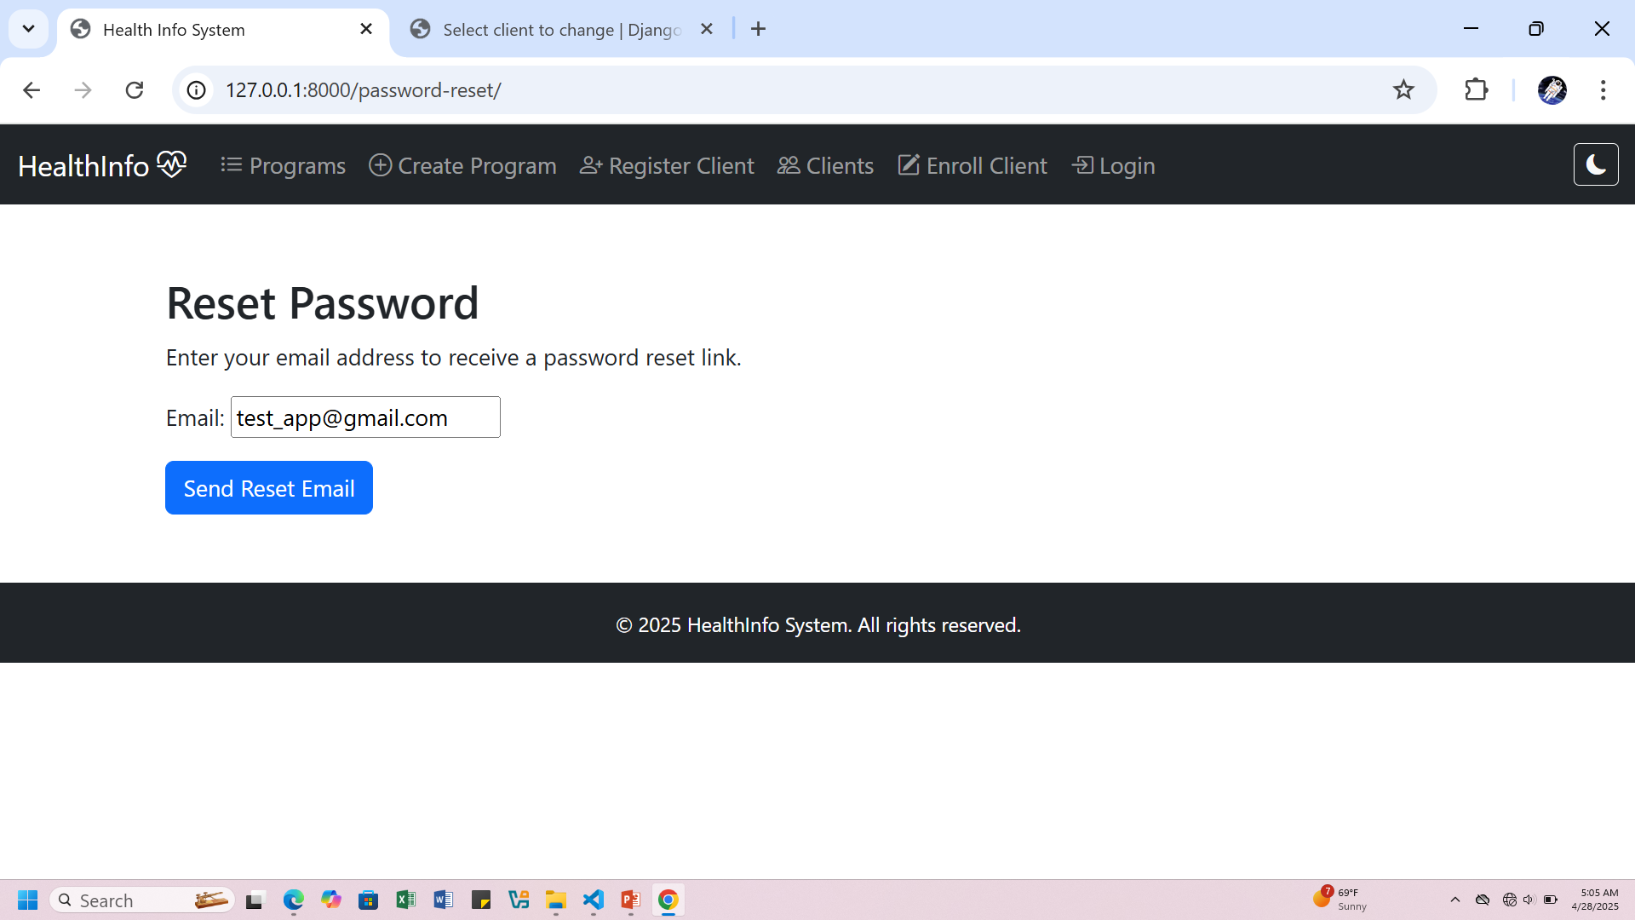

Slide 29
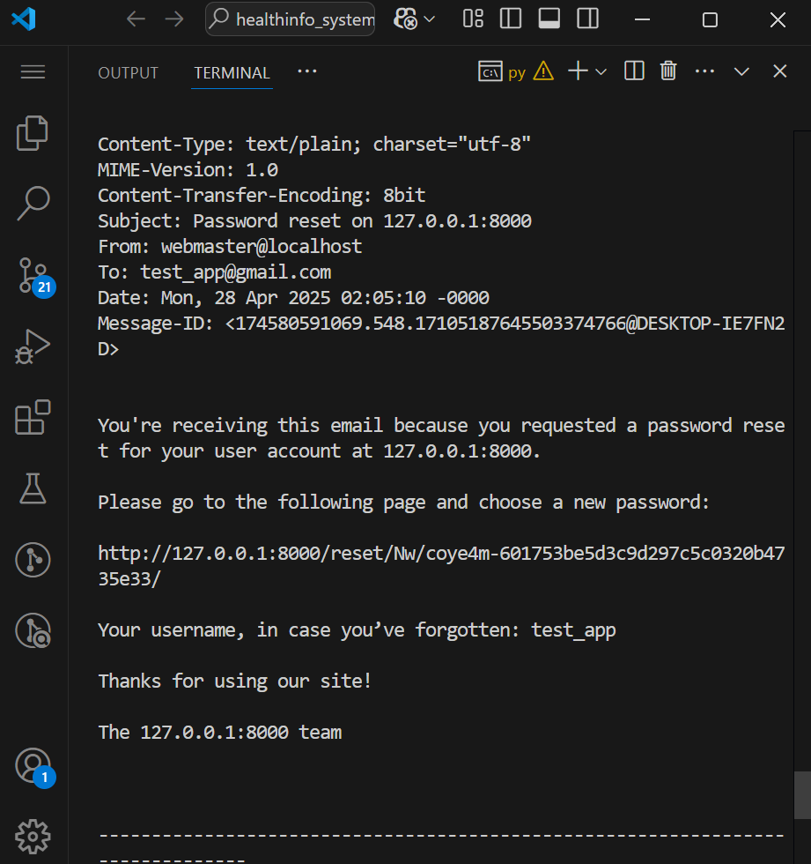

Slide 30
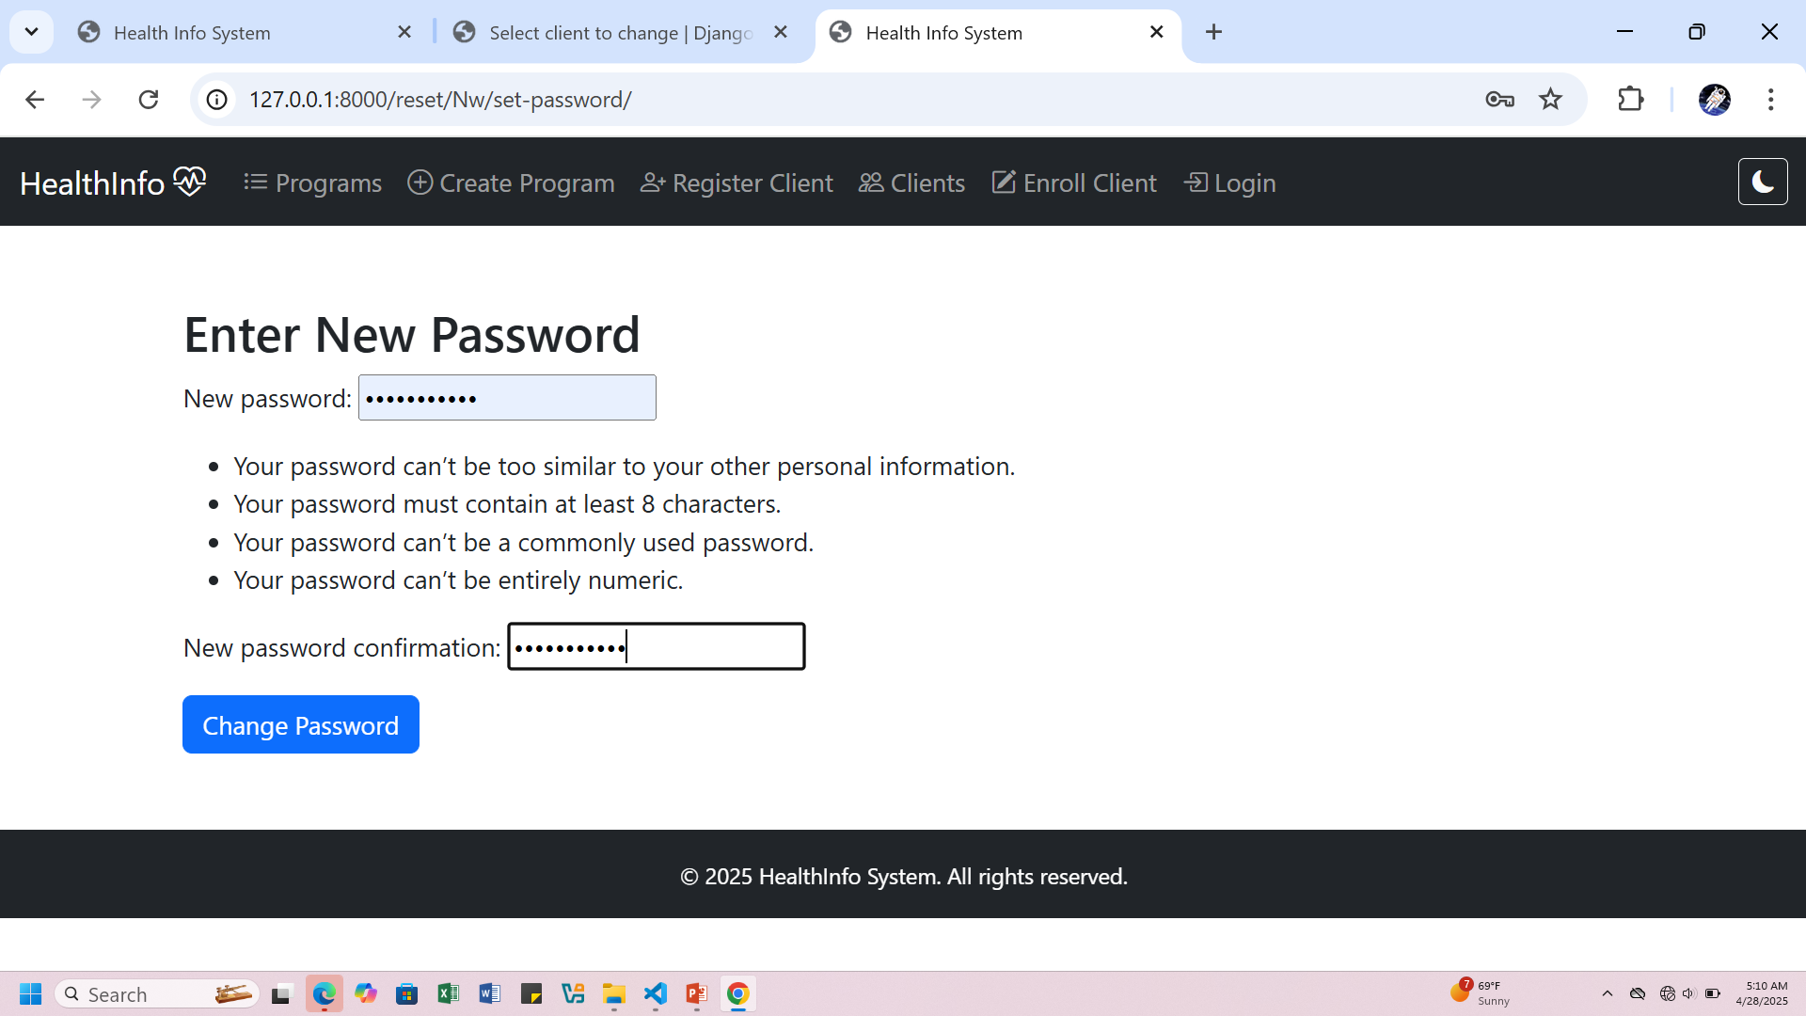

Slide 31
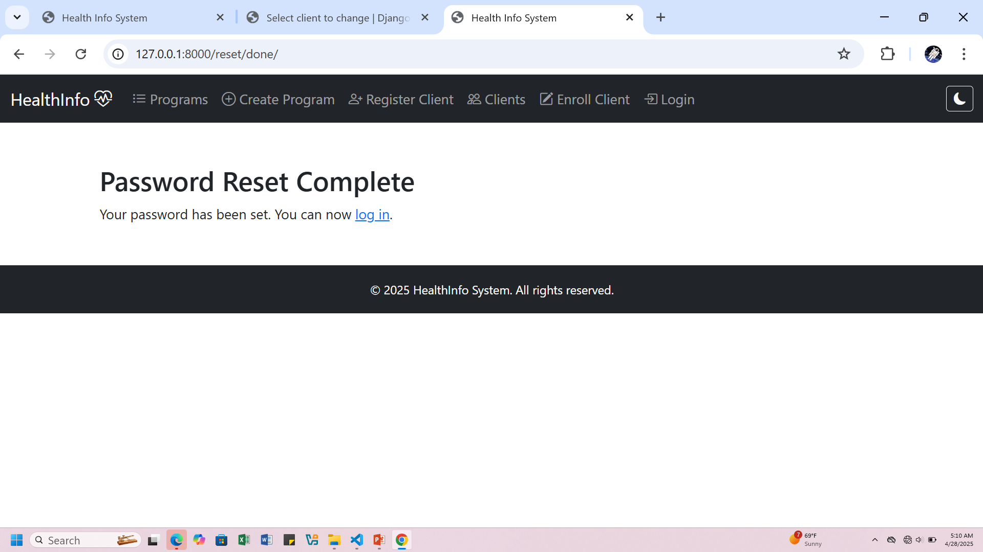

Slide 32
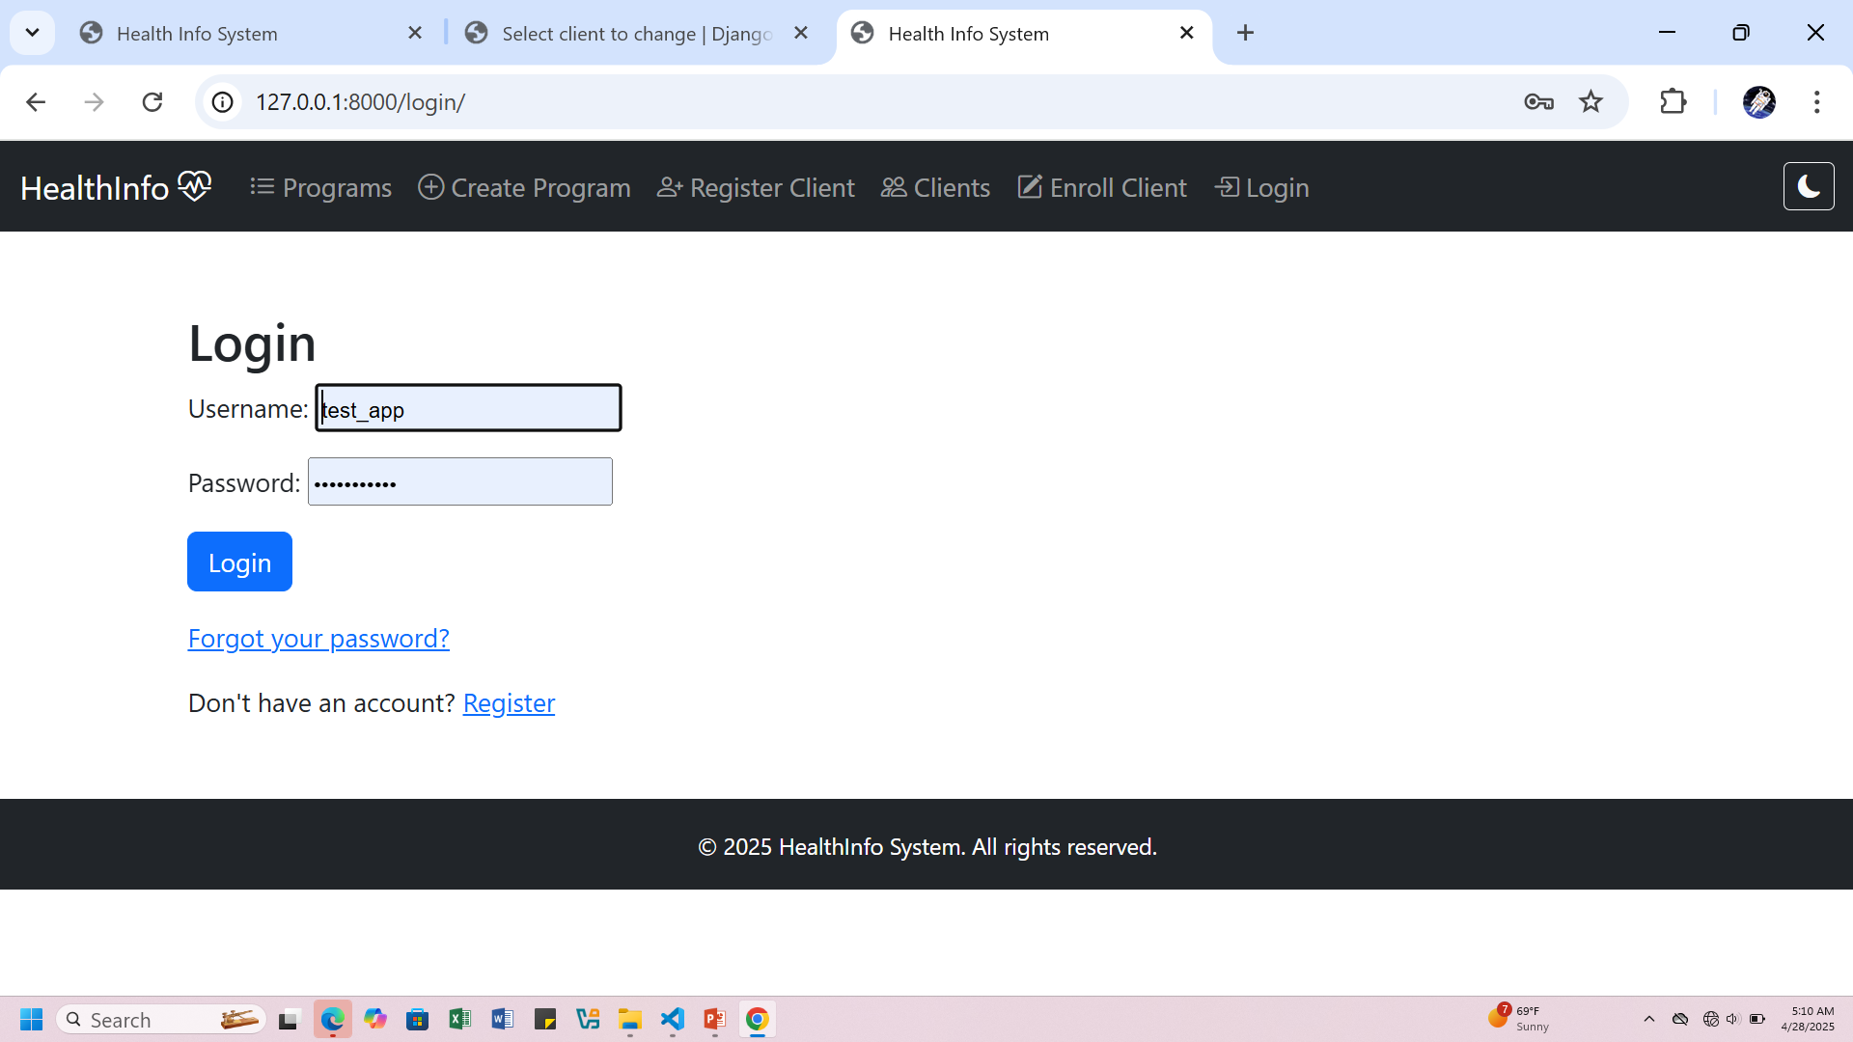

Slide 33
The End
Contact me at el.saha.mj@gmail.com

